Slide 1
Embedded System Design and the internet of things
Pat Pannuto
University of Michigan
Internet of Things Research Program
August 11, Stanford University

Slide 2
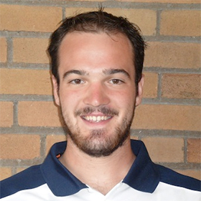
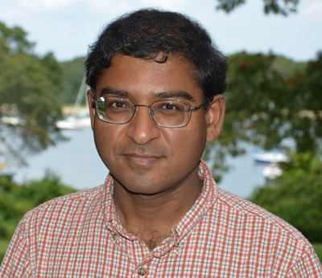
Pat Pannuto
Prabal Dutta
3rd Year Ph.D. Student, University of Michigan
BSE Computer Engineering, University of Michigan
Research:
Embedded systems, wireless technology, next-generation computing technologies
“Last Inch” Problem
Assistant Professor, University of Michigan
Ph.D. in CS from Berkeley, 2009
Research:
Networked embedded systems with applications to health, energy, and the environment
Regrets he cannot be here
Hosting a DARPA ISAT workshop
Notes:
Prabal Research: Everything in my list, plus…

Slide 3
Lab11 at Michigan: (Some of) What we do
eMbedded Gateway Cloud

Slide 4
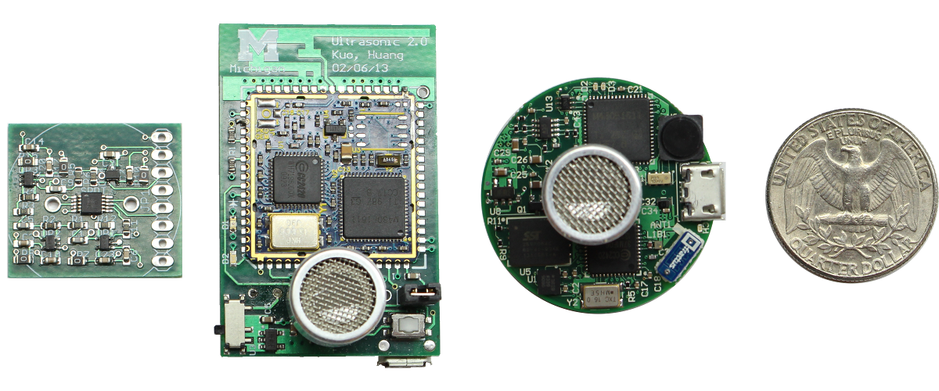
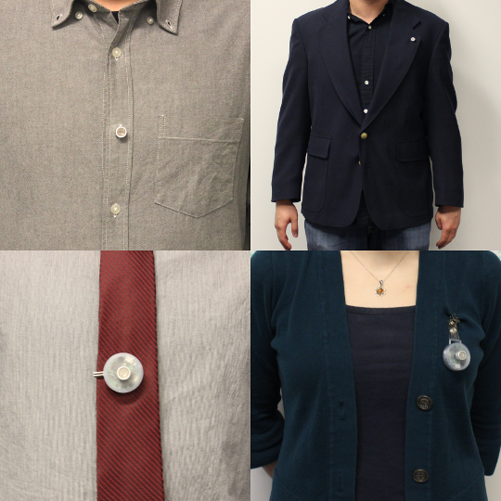
Lab11 at Michigan: (Some of) What we do
eMbedded
Opo
Goal:
Explore methods to enable high spatiotemporal human interaction tracking
Result:
Novel ultrasonic wakeup circuit enables ~2 s granularity with ~5 cm accuracy for 1 week on a 40 mAh battery

Slide 5
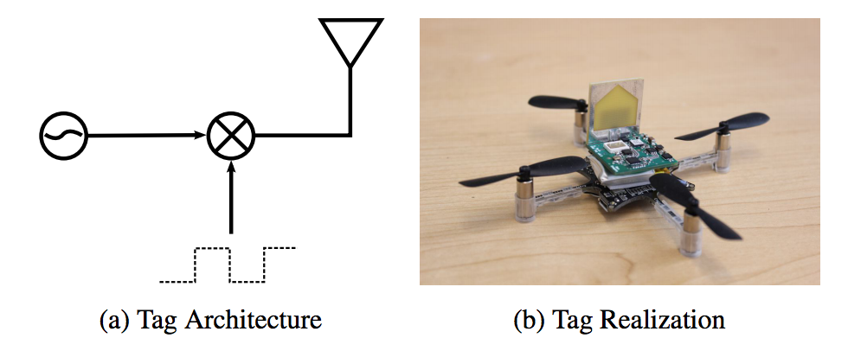
Lab11 at Michigan: (Some of) What we do
eMbedded
Harmonia
Goal:
Rapid, high accuracy, indoor RF TDoA localization
Track micro-quadcopters in real time
Approach:
UWB accuracy using NB frontends via impulses (TX) and band-stitching (RX)
20 cm avg error
40 cm 95%ile
56 Hz samples

Slide 6
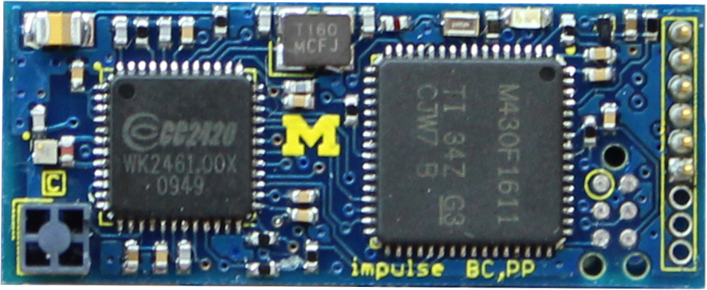
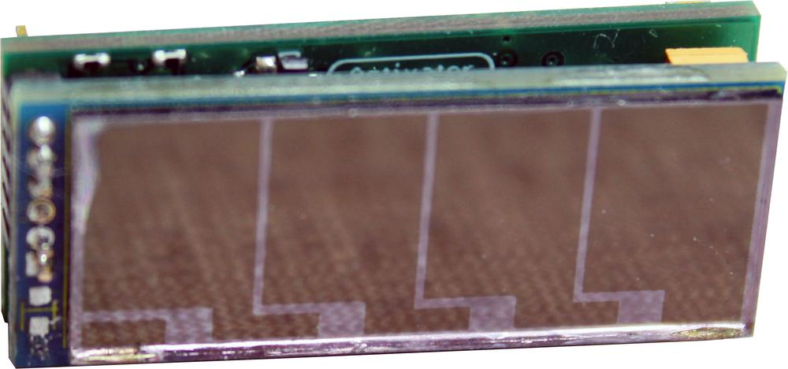
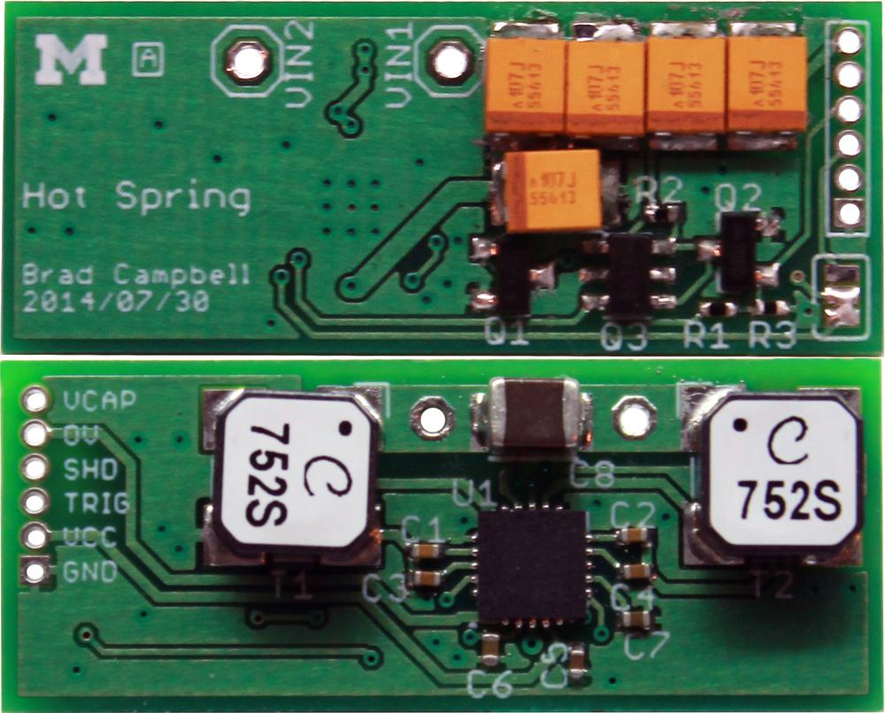
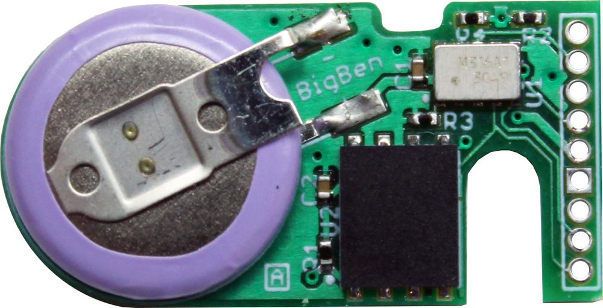
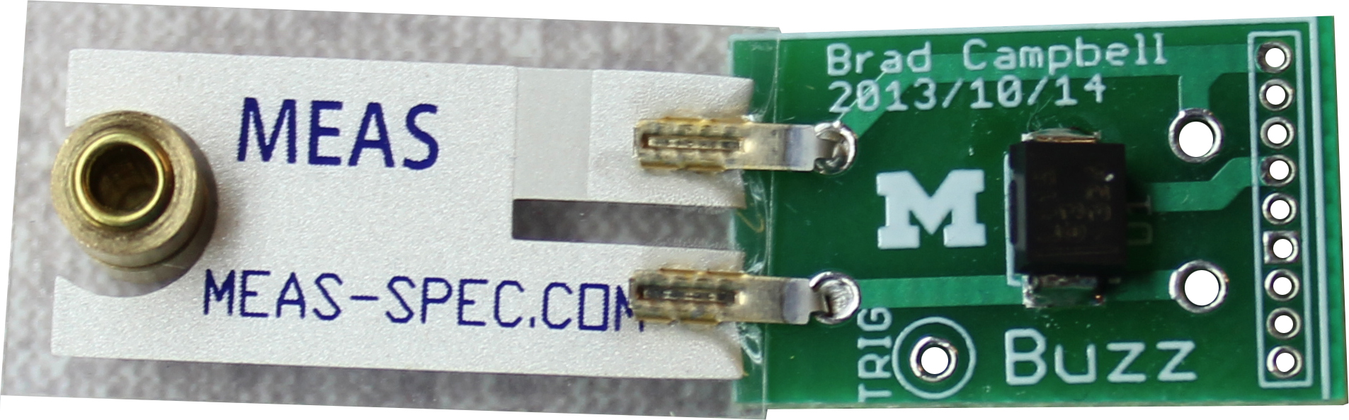
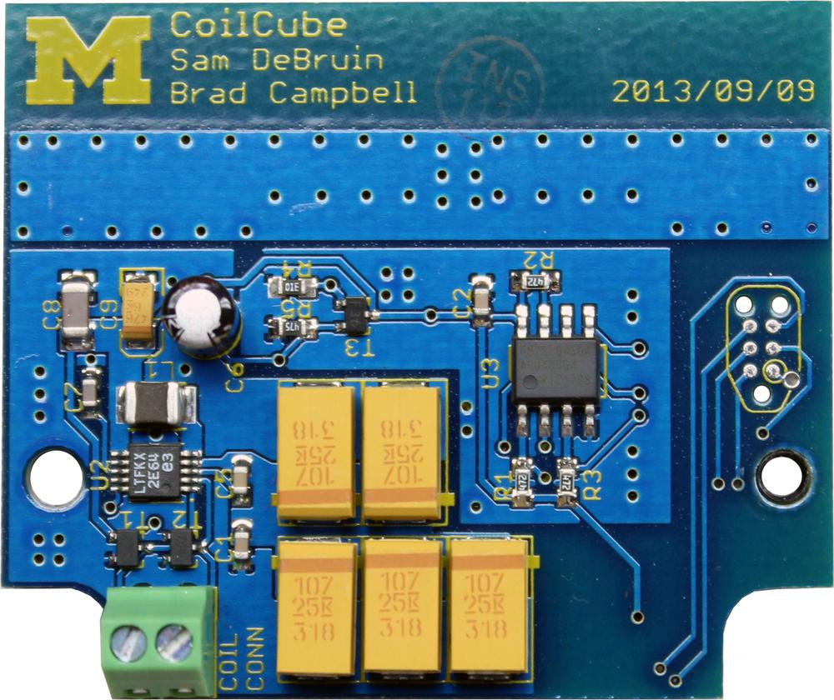
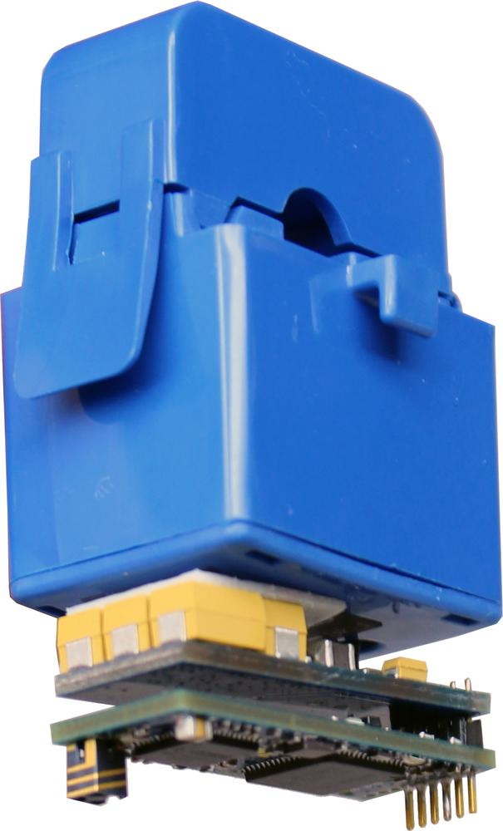
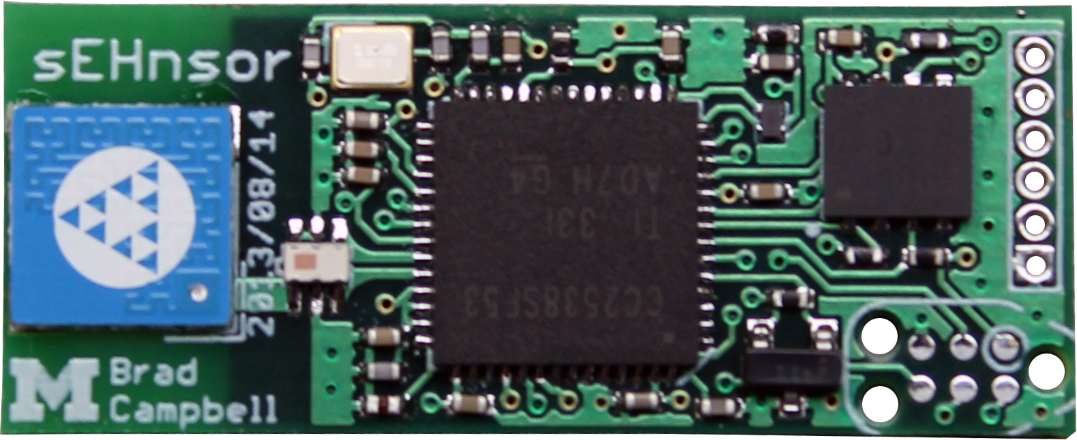
Lab11 at Michigan: (Some of) What we do
eMbedded
Monjolo Family
Original Hypothesis:
Estimate appliance energy use from side-channel emissions
Result:
Practical, battery-free* energy-harvesting sensors

Slide 7
Lab11 at Michigan: (Some of) What we do
eMbedded
Monjolo Family
Original Hypothesis:
Estimate appliance energy use from side-channel emissions
Result:
Practical, battery-free* energy-harvesting sensors

Slide 8
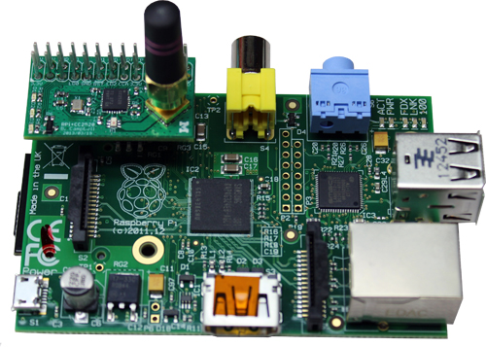
Lab11 at Michigan: (Some of) What we do
Gateway
“A necessary evil”
Gen 1: Rpi + CC2520

Slide 9
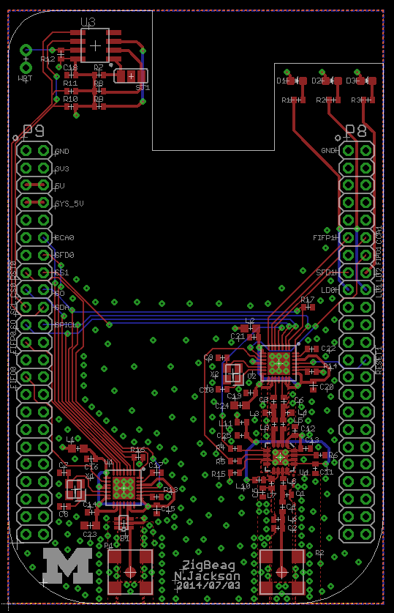
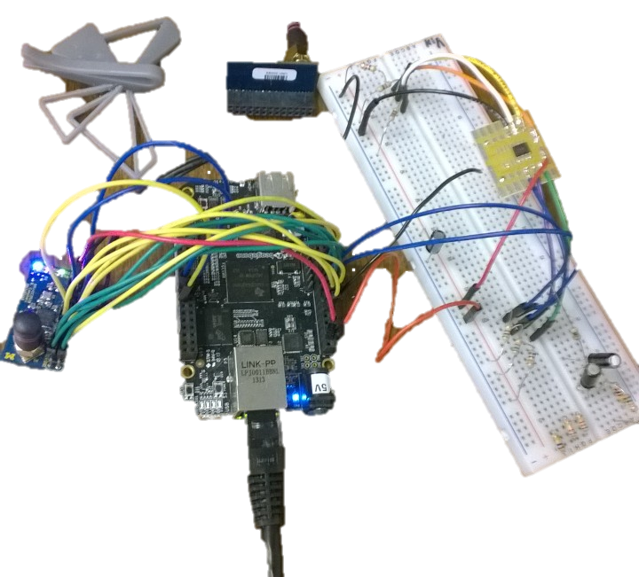
Lab11 at Michigan: (Some of) What we do
Gateway
“A necessary evil”
That may be evolving into an interesting area of research
Gen 1: Rpi + CC2520
Gen 2: BeagleBone Black
+ 2 x CC2520 + CC2591

Slide 10
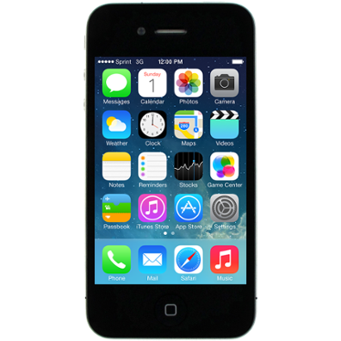
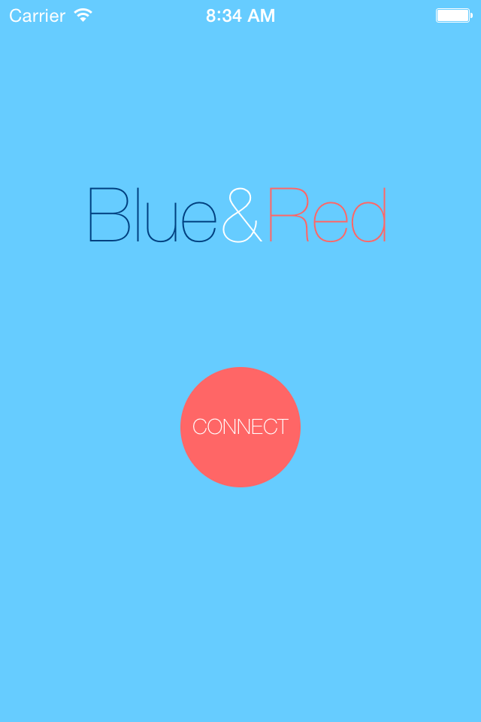
Lab11 at Michigan: (Some of) What we do
Gateway
“A necessary evil”
That may be evolving into an interesting area of research
Bluetooth Low Energy
Smartphone as a gateway
Gen 1: Rpi + CC2520
Gen 2: BeagleBone Black
+ 2 x CC2520 + CC2591

Slide 11
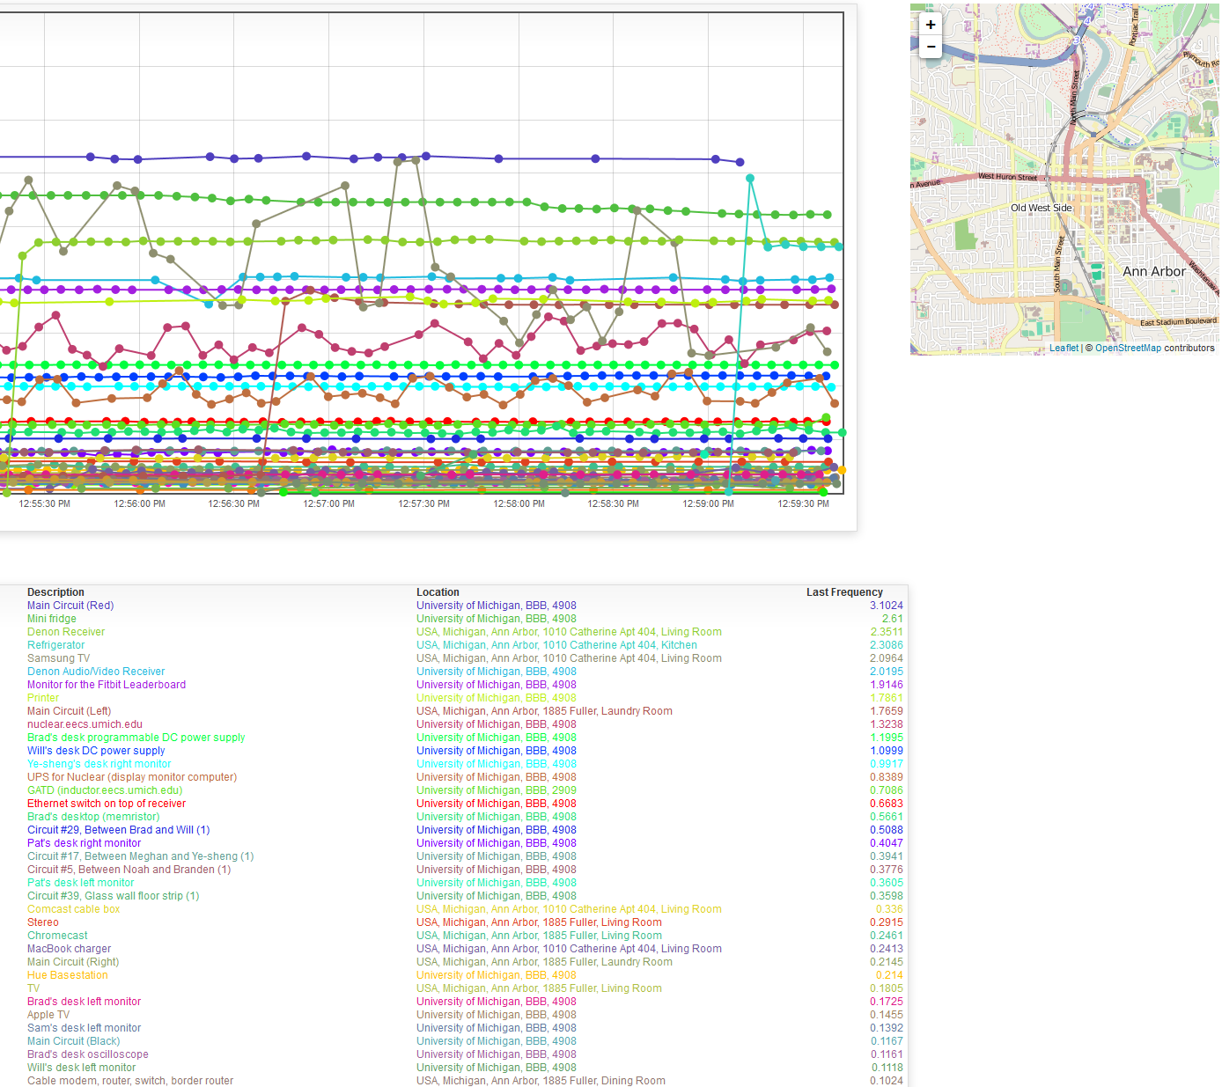
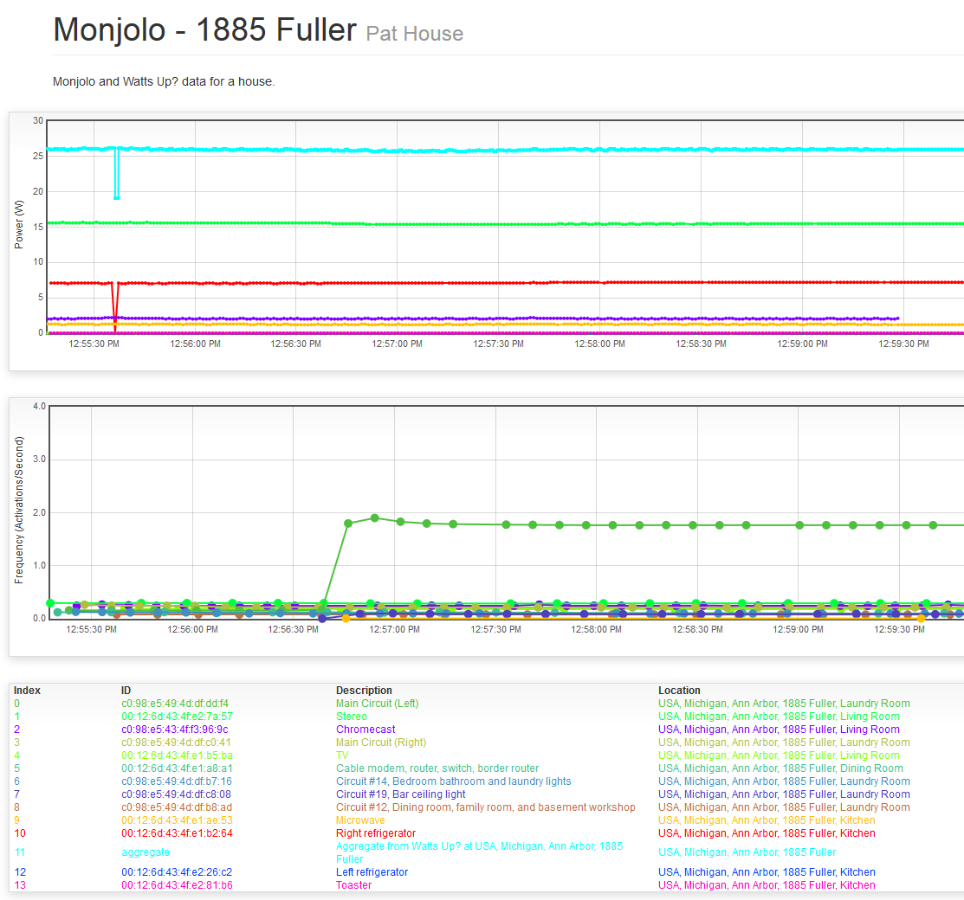
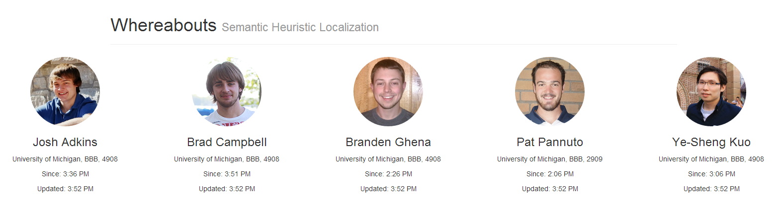
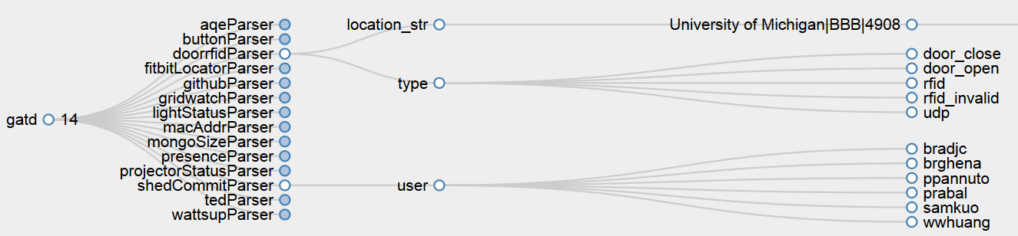
Lab11 at Michigan: (Some of) What we do
Cloud
Never say “No”
Collect and store all data, figure out what to do with it later
Optimize for real-time / streaming
Easy to archive a stream to more traditional DB for analysis
Leverage “Web Scale”
Enough technology exists to build highly scalable infrastructure quickly
MongoDB + RabbitMQ + SocketIO
Get All The Data

Slide 12
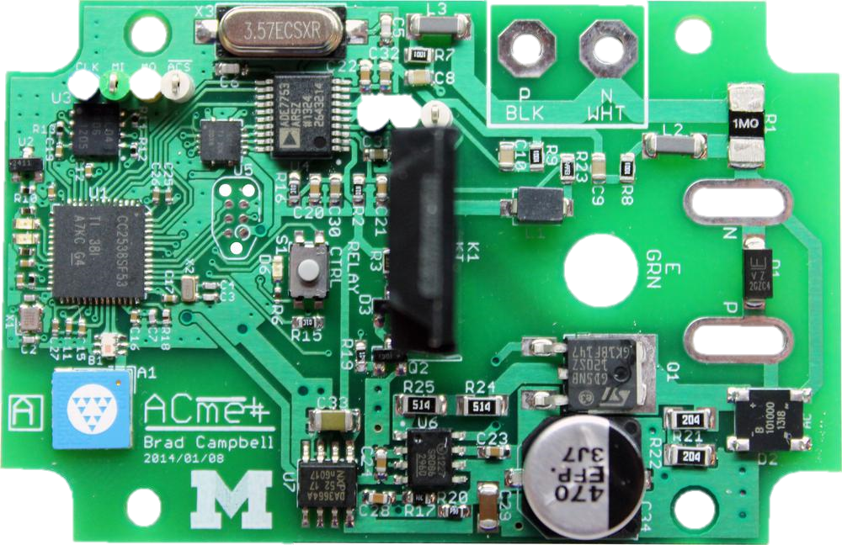
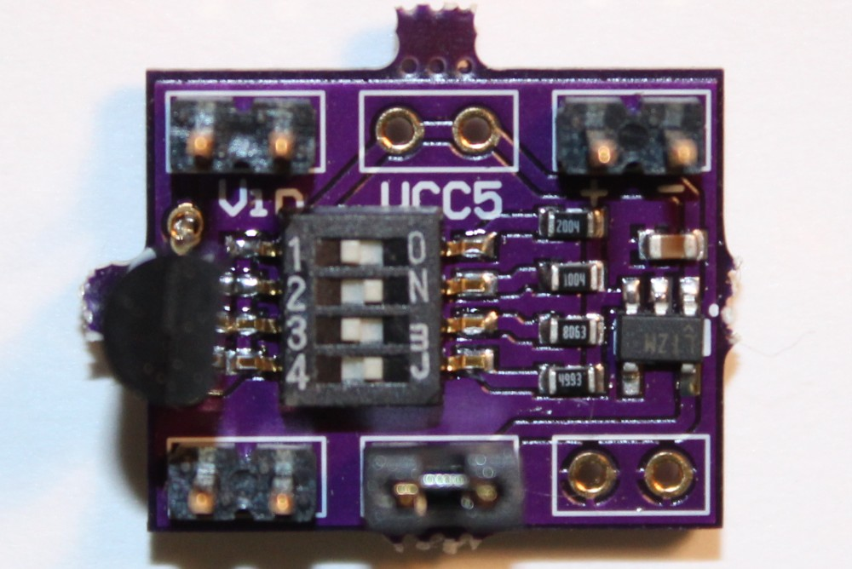
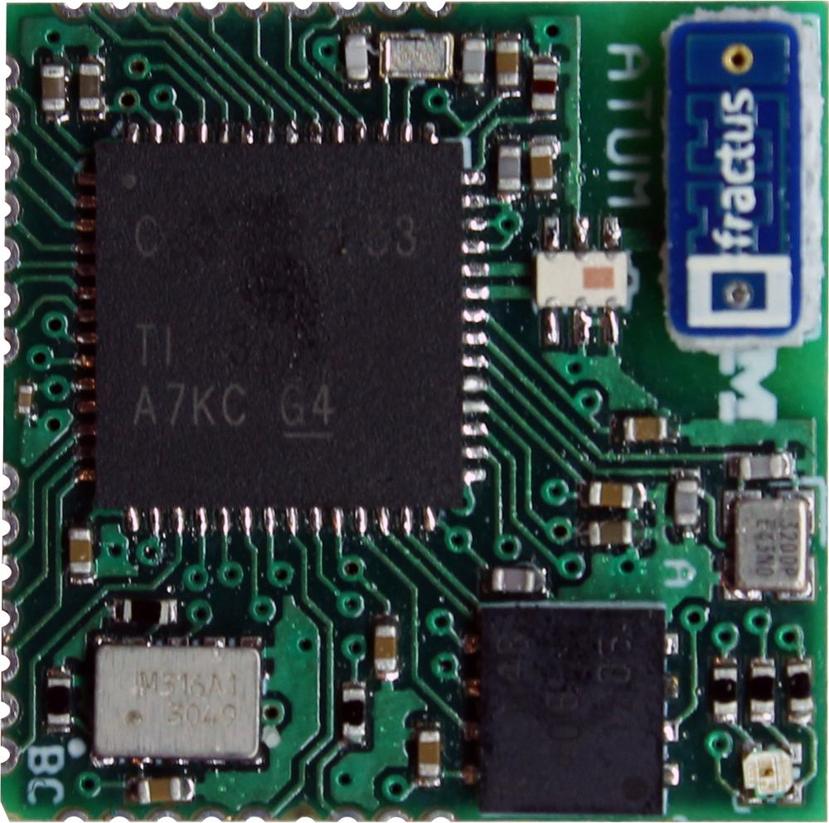
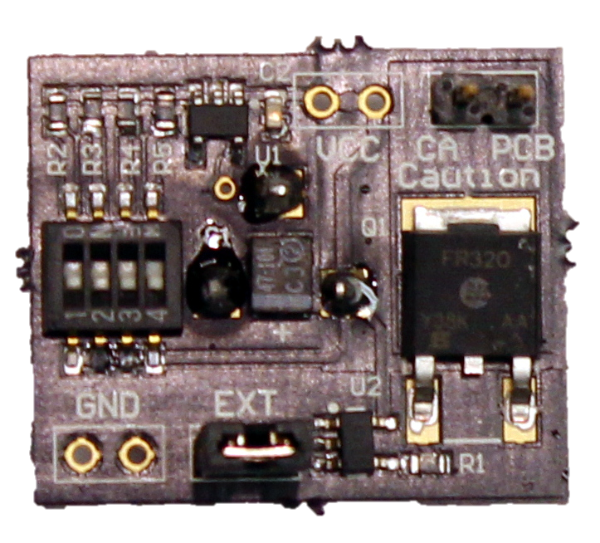
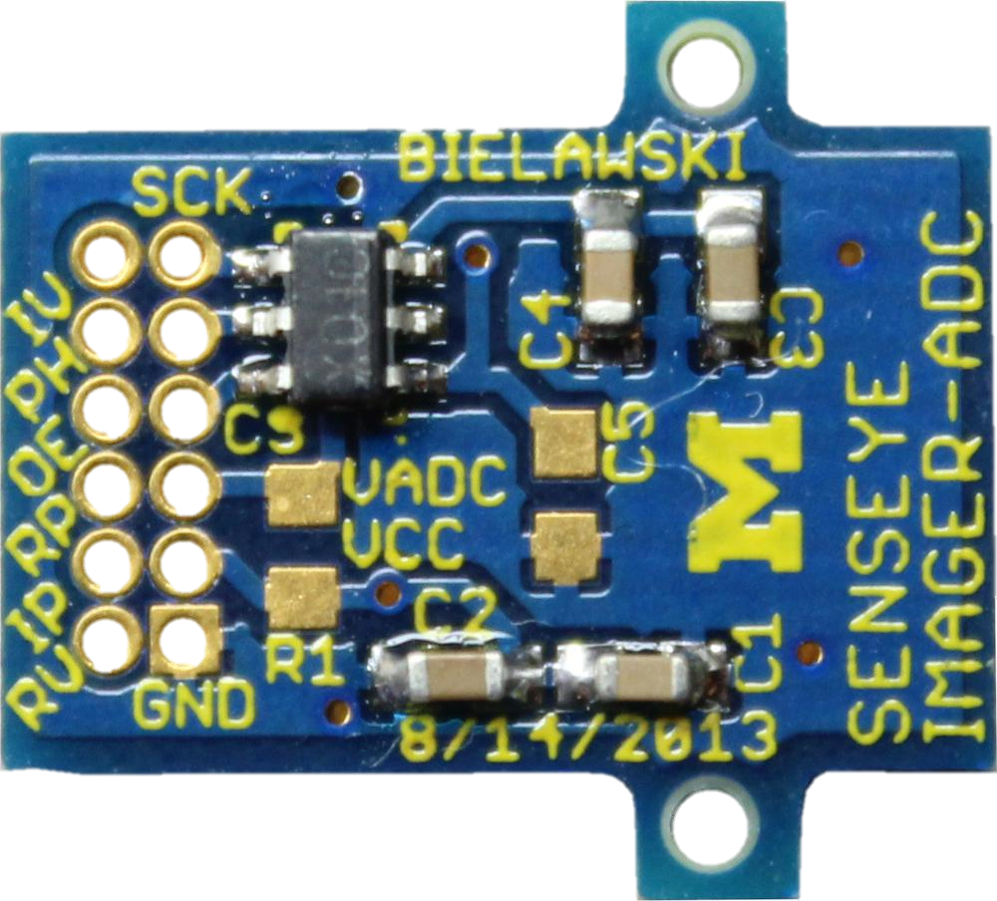
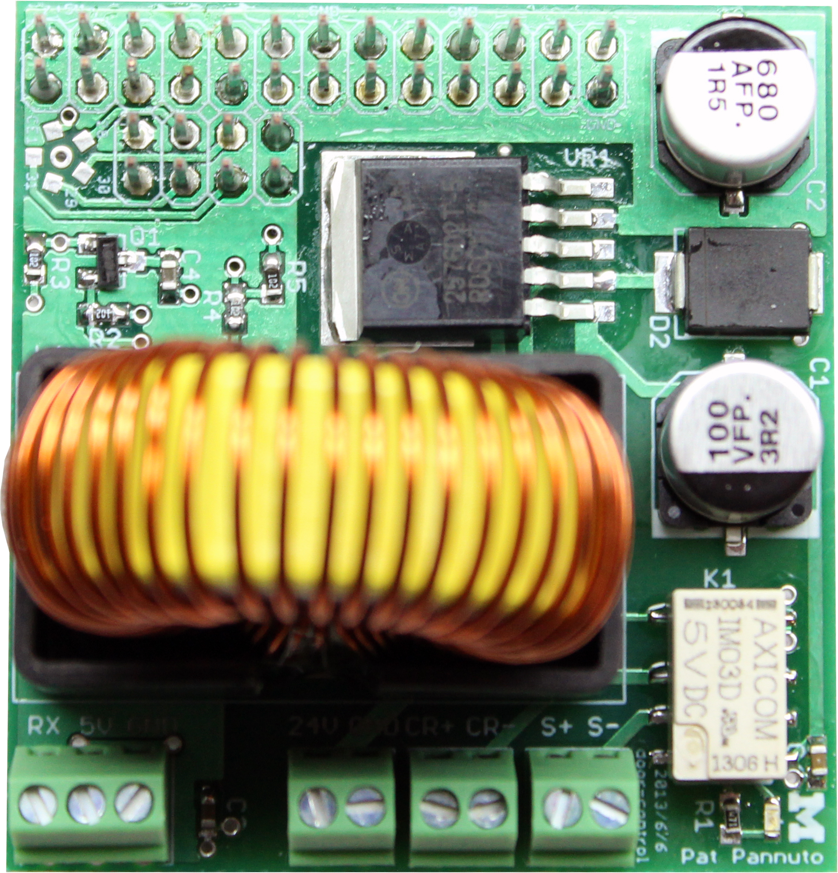
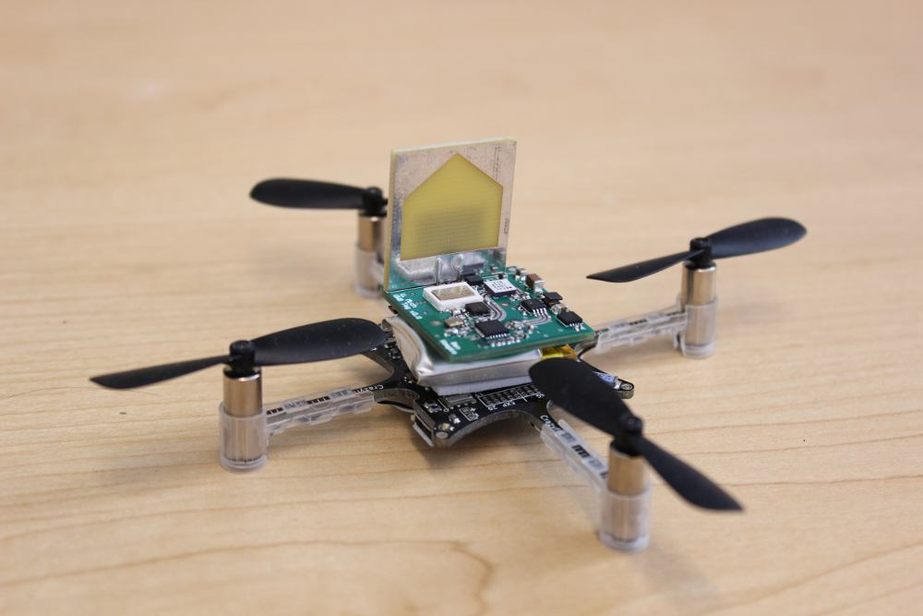
Lab11 at Michigan: (Some of) What we do
eMbedded Gateway Cloud
Embedded Systems
Built in the last 365 days
Bluetooth Low Energy
Smartphone as a gateway
Get All The Data
Gen 1: Rpi + CC2520
Gen 2: BeagleBone Black
+ 2 x CC2520 + CC2591

Slide 13
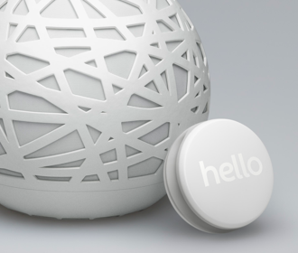
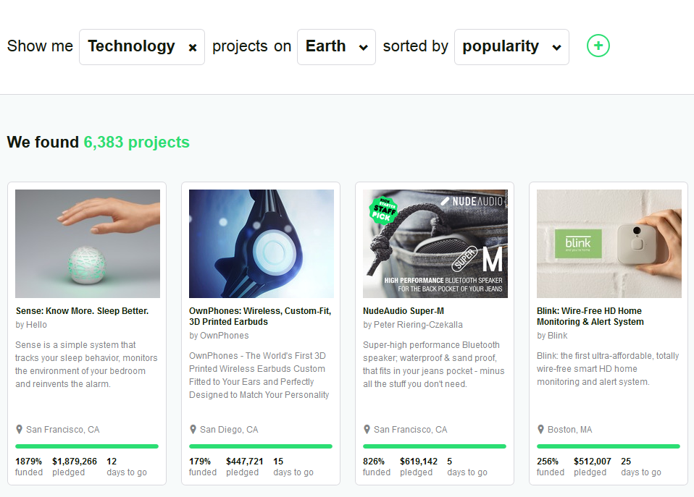
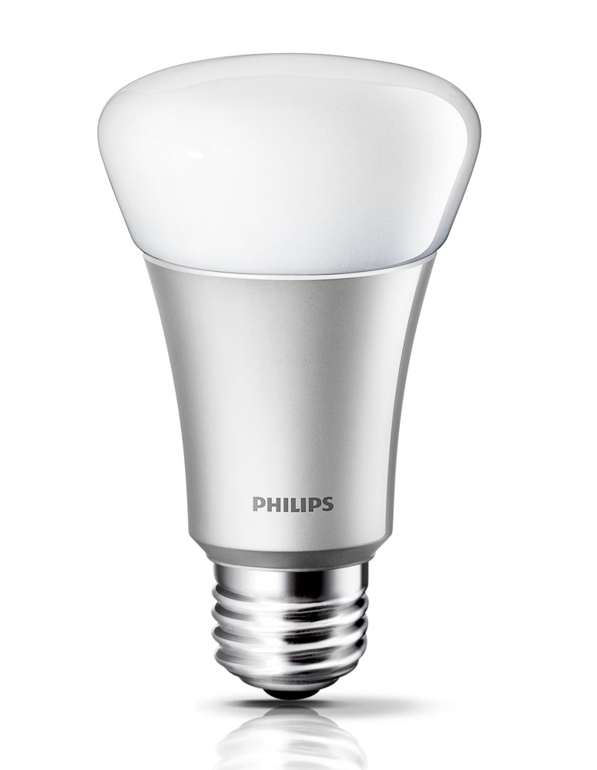
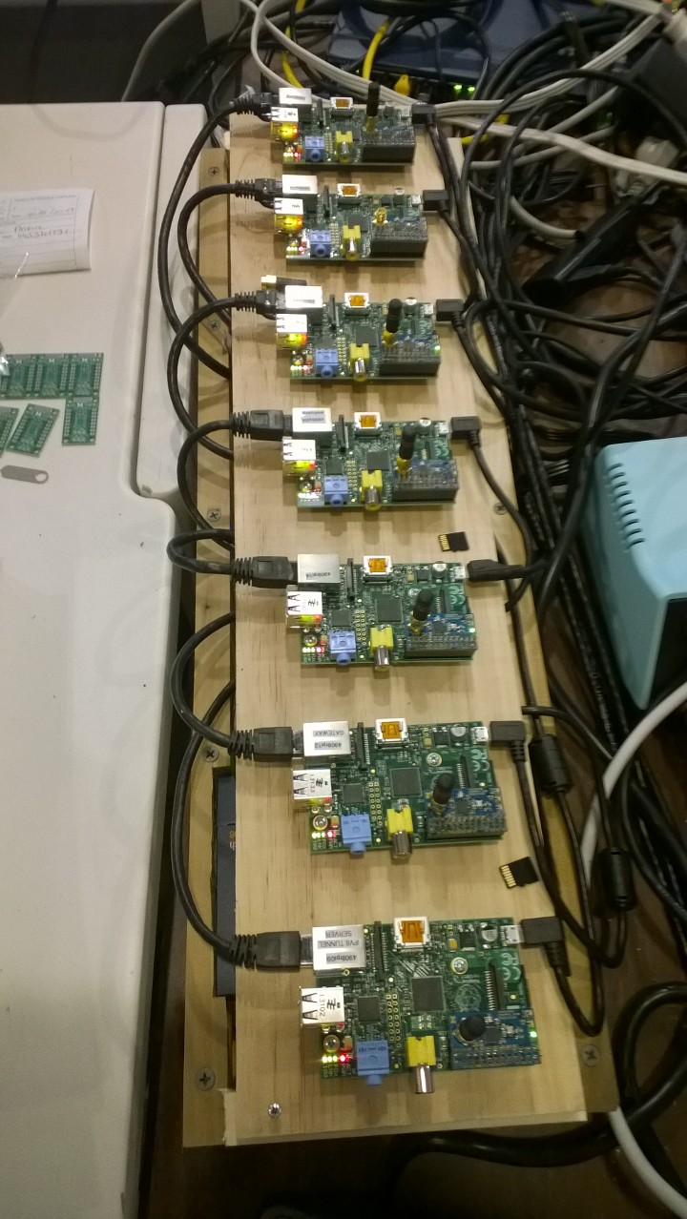
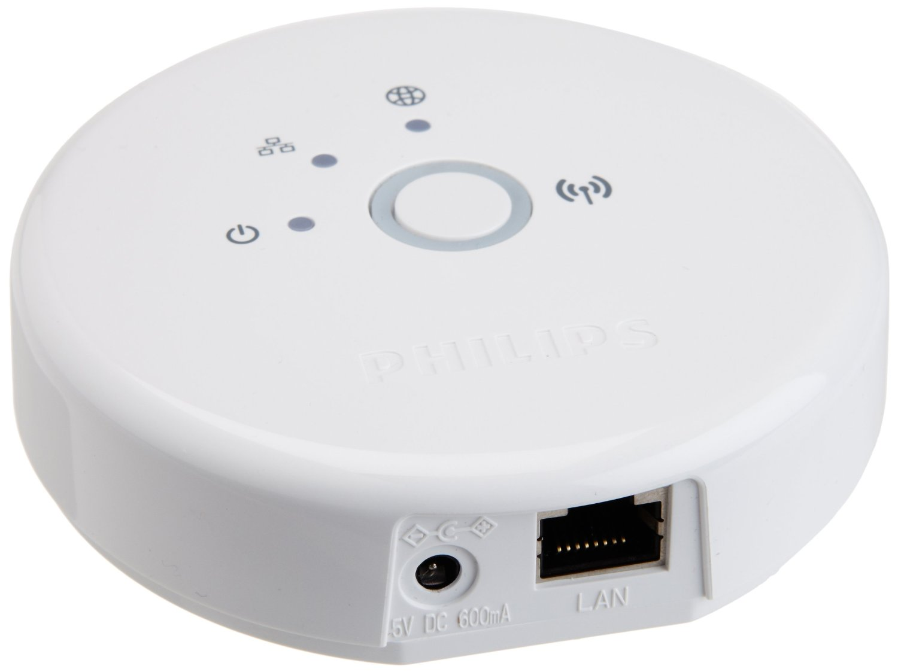
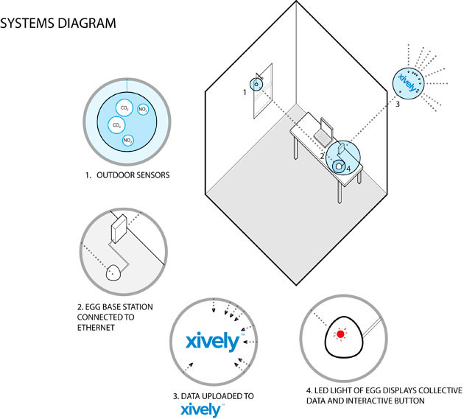
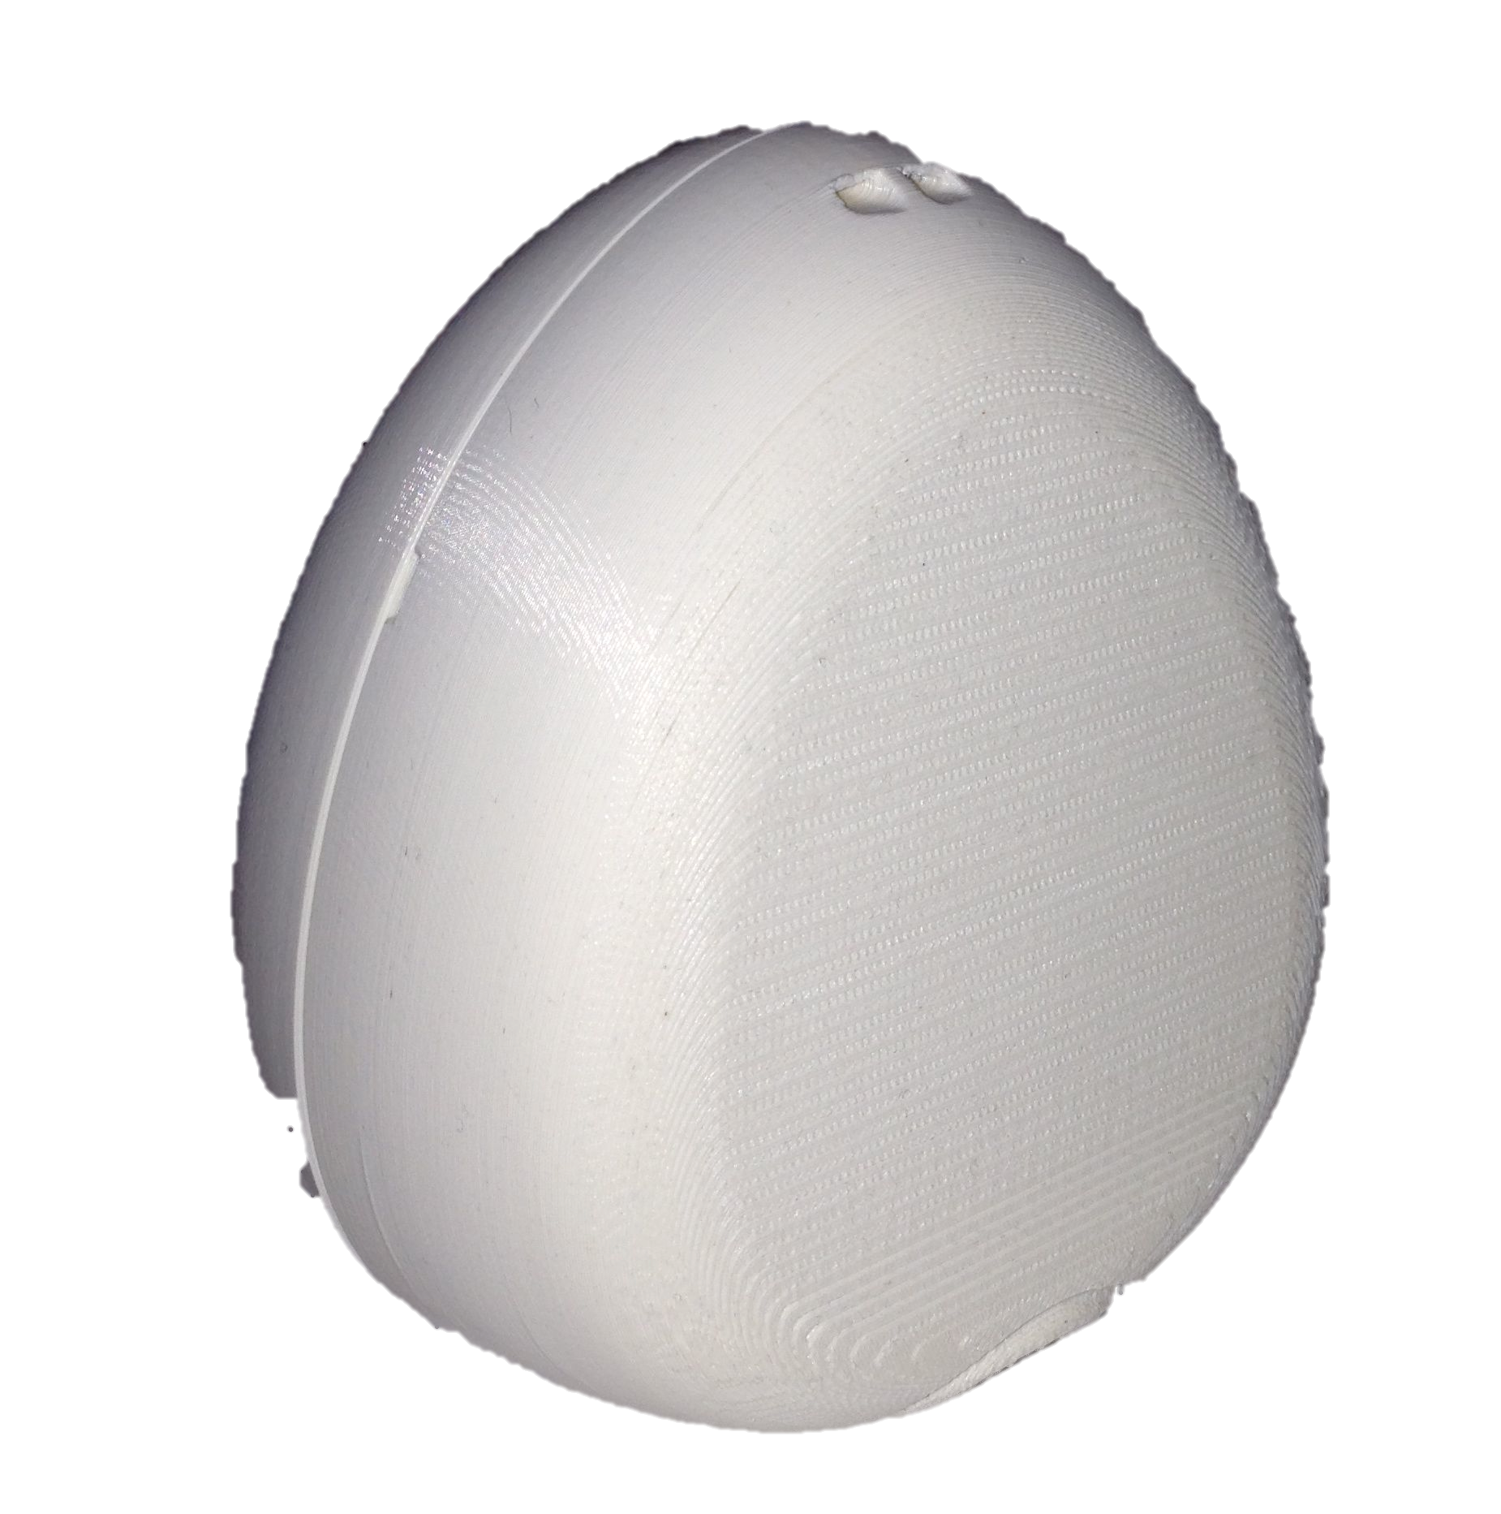
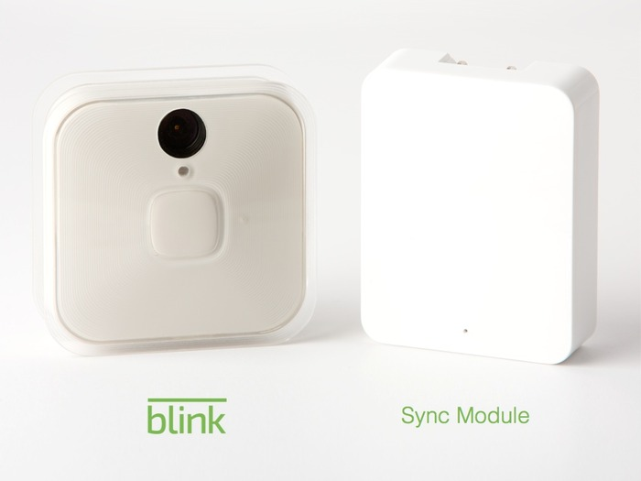
The Gateway Problem
All 802.15.4 Gateways

Slide 14
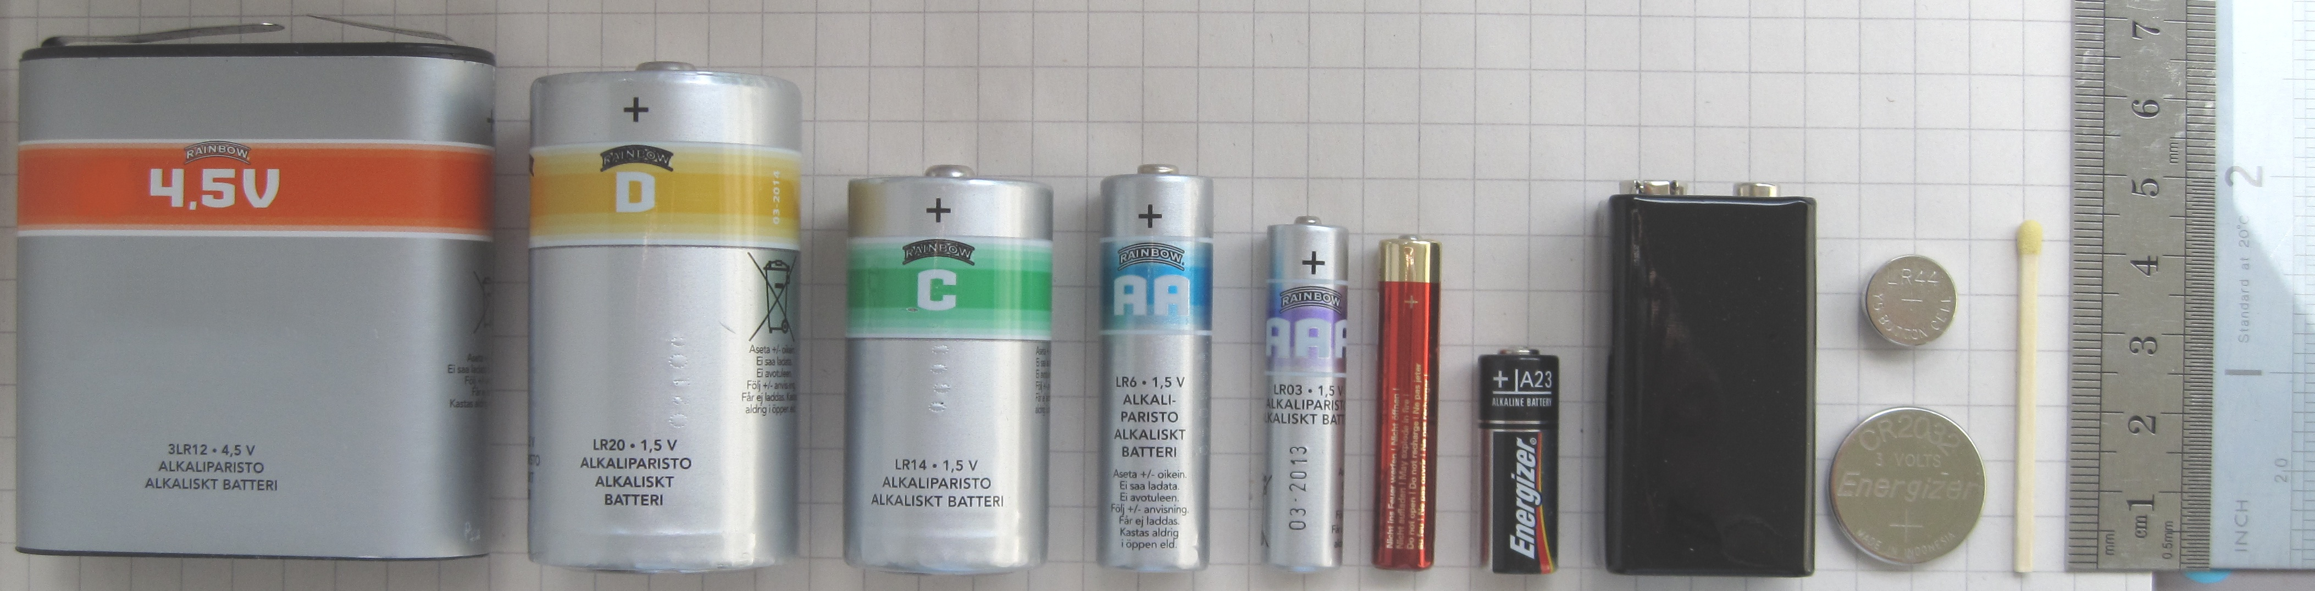
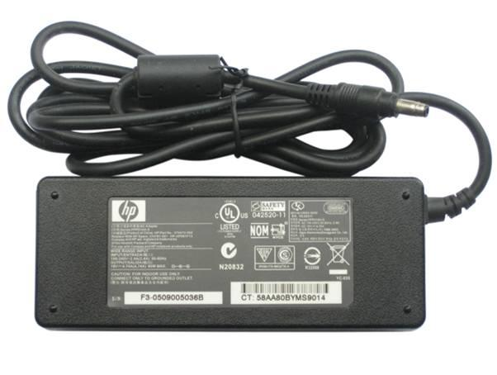
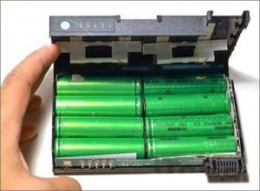
The (mostly) universal gateway worked for WiFi, why not us?
Notes:
Embedded devices have small batteries, but more critically WiFi devices are designed to be recharged

Slide 15
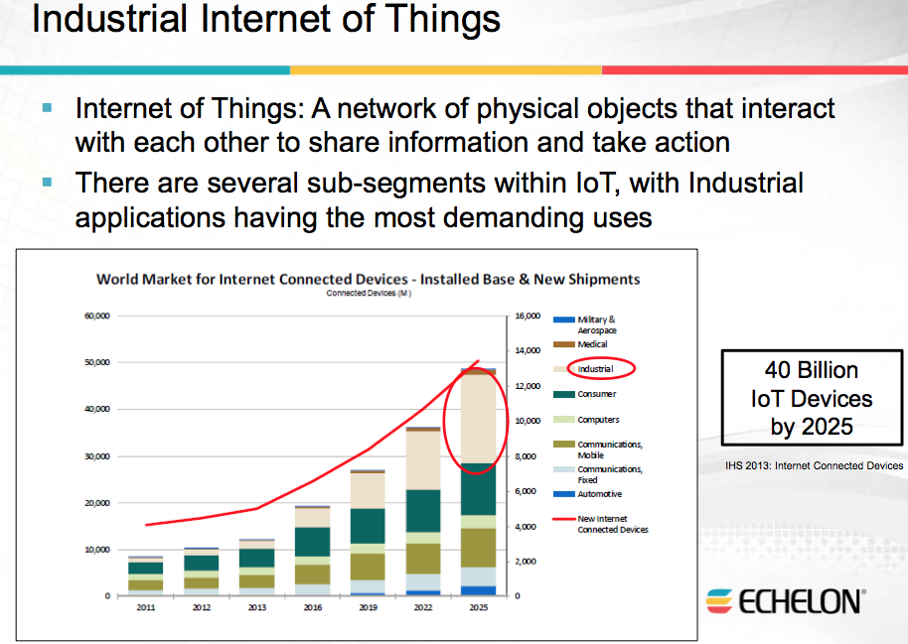
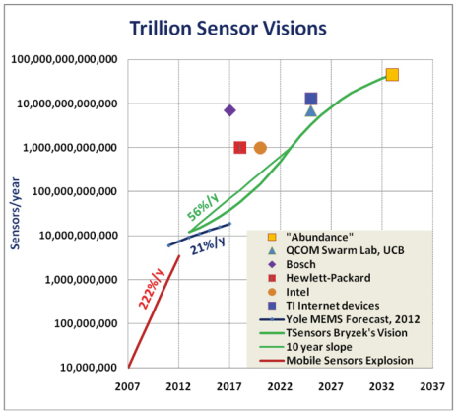
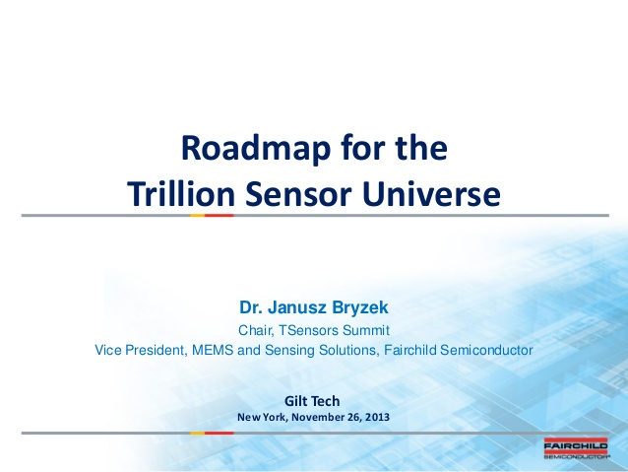
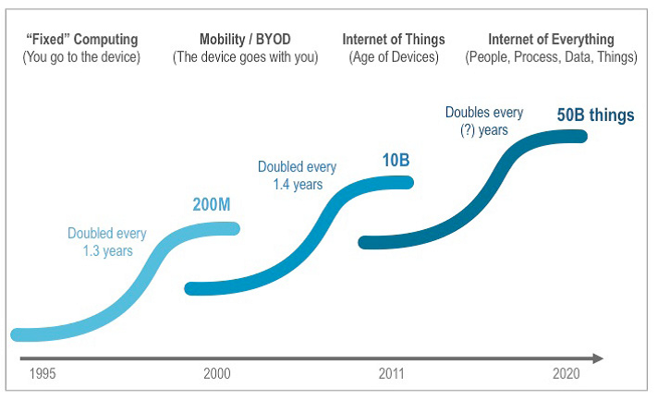
A Trillion Sensors is a Trillion Batteries
Claim 1
The majority of IoT devices in
5-10 years will be disposable
Claim 2
5-10 years after that, many will be energy-harvesting, energy-neutral systems with “infinite” lifetimes

Slide 16
The lifetime of a disposable IoT device is defined by the energy it ships with (or can harvest)
Thus, we need something more energy-efficient than 802.11
But what?
Self-Organizing (Sohrabi ’99), LEACH ’00, Adaptive Rate Control (Woo ‘01), S-MAC ‘02, WiseMAC ‘04, B-MAC ‘04, Adaptive LPL ‘07, RI-MAC ‘08, A-MAC ‘10, GLOSSY ‘11, LPB ‘12, Chaos ‘13, [To Appear: EkhoNet ’14]…
ZigBee, 802.15.4e, CTP
Best choice is system / application dependent
Wakeup (“LPP”, Musaloiu-E. et al., IPSN’08)
Discovery (“Disco”, Dutta et al., Sensys’08)
Unicast (“RI-MAC”, Sun et al., Sensys’08)
Broadcast (“ADB”, Sun et al., Sensys’09)
Pollcast (“Pollcast”, Demirbas et al., INFOCOM’08)
Anycast (“Backcast”, Dutta et al., HotNets’08)
Notes:
n.b. yes, I realize I stole this list from an A-MAC talk that shortly after argues that A-MAC provides [nearly] all these features in [many] scenarios, but there’s enough qualifiers and caveats to that claim that I feel I can make the point with this list still.

Slide 17
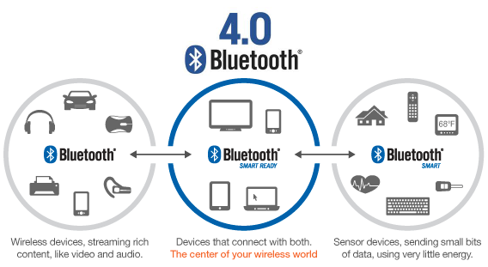
Bluetooth Low Energy – A MAC convergence for non-mesh applications
BLE doesn’t mesh, but many applications don’t need mesh – especially [primarily] collection-based ones

Slide 18
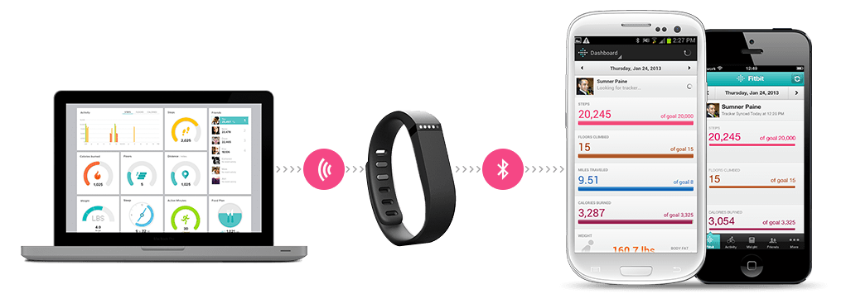
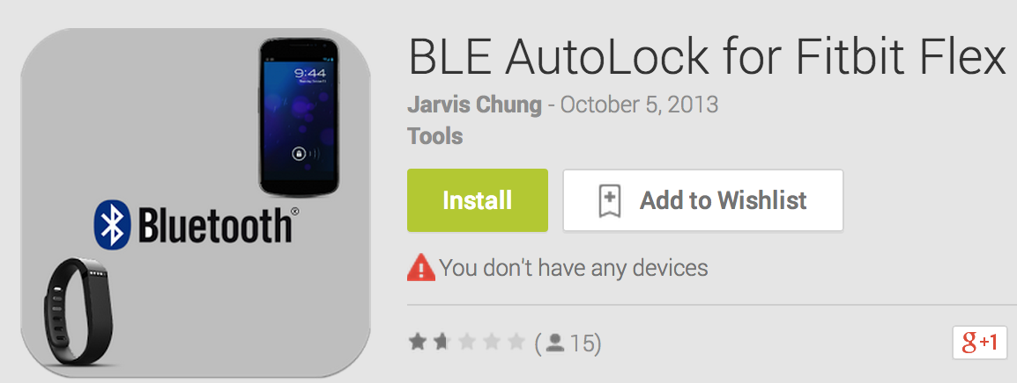
BLE as a backhaul for Personal Area Networks
This is in commercial technology now
Apps are emerging to provide other services as well
Can this network reliably provide other, more demanding applications (e.g. firmware updates? + different class of trust for this application)

Slide 19
BLE as a backhaul for general sensor networks “Reverse Data Muling”
Can smartphones + BLE act as a semi-universal gateway?
Are there security concerns with auto-connecting to arbitrary Bluetooth devices?
How does an embedded device trust arbitrary phones?
Who pays for the data? Can this run as a carrier service?
[Micropayments?]

Slide 20
The gateway problem is a fundamental problem
Low-power IoT devices require low-power networks
Which by their nature have limited range
Something (gateway) must bridge a low-power network
It is part of the architecture for good reason
But it is burdensome in practice to deploy
One Potential Plus
Gateway as a privacy-preserving bottleneck

Slide 21
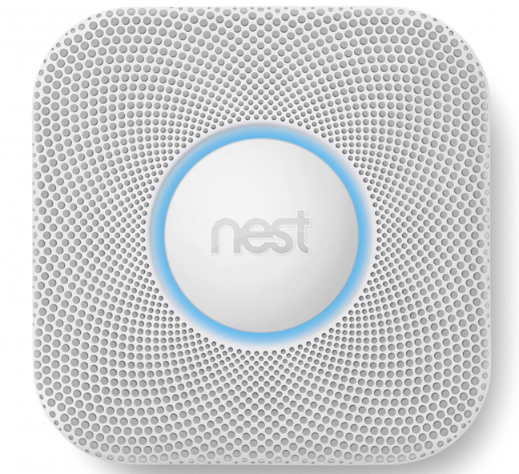

The Gateway Problem Nest Google Gets It
Nest Products are Trojan Horse IoT Gateways

Slide 22

Motivation for burdening the gateway node: Masking less-performant, less-reliable low-power networks
Low Power Networking
Powered Devices
Less bandwidth
The Internet
High bandwidth
Reasonably low latency
Reliable
Low Power Networking
Battery-backed
Less bandwidth
Higher latency
Unreliable
Energy-Harvesting
Short Transmissions
Minimal bandwidth
Non-deterministic latency
Highly Unreliable
Possibly Unidirectional

Slide 23
Motivation for burdening the gateway node: Centralizing computation to minimize costs
One :: Many
Minimize Cost
Limited computing power
Limited program space, memory

Slide 24
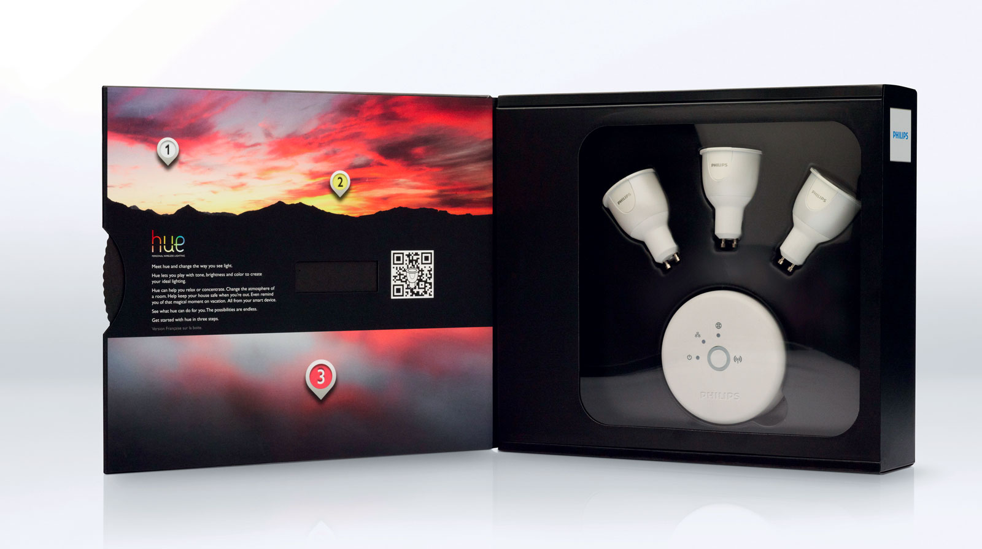
A Case Study: The risks of relying on the gateway to be anything more than a gateway

Slide 25
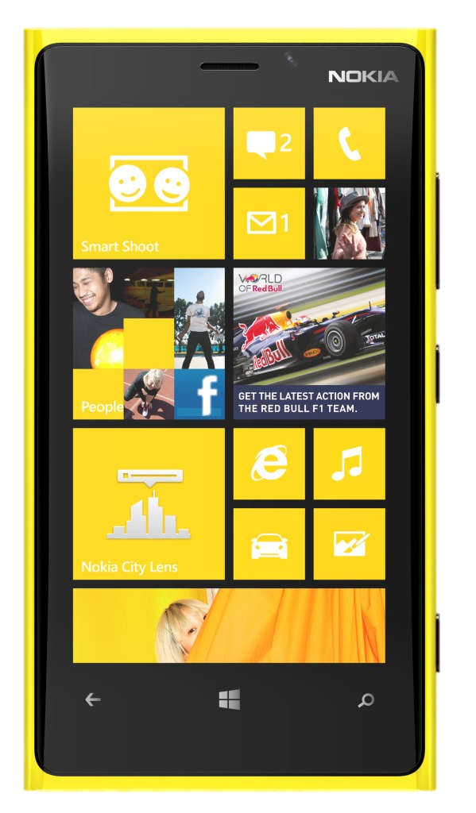



Hue authentication: App to base station
?
?

Slide 26
Hue authentication: Base station to bulb
Bulbs and base station ship pre-configured with shared secrets

Slide 27
Hue Security, OR end-to-end violation by example
Does this architecture guarantee that all commands
are sent by an authorized owner of the light?
?

Slide 28

Any Hue bulb will trust any Hue base station
One master key shared by all Hue base stations
http://www.zigbee.org/portals/0/documents/events/2012_04_26_ZLL-Green%20Lighting-Heile.pdf

Slide 29

Two-level trust: Who’s trusted now and who to trust
Bulbs and base station ship pre-configured with TWO shared secrets

Slide 30

The importance of understanding a threat model (and why what came before actually wasn’t so bad)
Reduces security to physical proximity (RSSI)
http://www.zigbee.org/portals/0/documents/events/2012_04_26_ZLL-Green%20Lighting-Heile.pdf

Slide 31

And then usability demanded an extension that makes it worse
Authenticate via immutable 6-digit bulb serial number
Off-the-shelf ~40 ms per authentication attempt (due to slow web server)
One-time cost to brute force:
Just over a week
ArsTechnica, 5 Nov 2013:
http://arstechnica.com/gadgets/2013/11/philips-hue-family-gets-brighter-with-new-type-of-light/

Slide 32







Embedded Device Design Small things without buttons

Slide 33

Why now?
Why are so many IoT devices being built?
What opened the floodgates?
Google Ngram Viewer
Notes:
Pivot slide from top-down to bottom up view, looking at the HW and components that make up embedded systems

Slide 34






The smartphone is an embedded system and a micro-PC
Very mature toolchains for embedded ARM cores
Driving down size, cost, and energy of peripheral sensors
gcc
clang
msccv

Slide 35



Wait, why do we need IoT if there are smartphones everywhere?
!=
0.5 mm
3.5 mm
2 mm
!=

Slide 36





A reminder: Energy is king
Life Expectancy:
40 mAh
CAN ONLY
Notes:
Comment on improved battery quality here. LiIon and LiPo have great energy density / performance characteristics

Slide 37





Moore’s Law Computing power in embedded
Low power 32-bit microcontrollers becoming reality
TI MSP430
http://forum.allaboutcircuits.com/blog.php?b=551
Atmel SAM4L
http://atmelcorporation.wordpress.com/2013/04/08/whats-new-in-atmels-arm-mcu-picopower/
Suvolta
http://www.suvolta.com/technology/ddc/
Notes:
4 mW / 0.9 V = 4.4 mA / 350 MHz = 12.68 uA / MHz [marketing slide, caveat emptor]
http://www.suvolta.com/technology/ddc/

Slide 38
Moore’s Law and Memory SRAM hasn’t followed the same trend
SRAM ceiling
MSP430
0.125-66 kB
ST Micro STM32L
4-80 kB
Atmel SAM4L
32-64 kB
NXP LPC1xxx
1-36 kB
Notes:
MSP430
130 uA / MHz
0.125-66 KBytes
ST Micro STM32L
177 uA / Mhz
4-80 KBytes
Atmel SAM4L
90 uA / MHz
SRAM = 32-64 KBytes

Slide 39
Why has embedded memory size not followed the rest of computing?
Q: Servers have terabytes of RAM, why is embedded memory following a slower trajectory?
A1: Demand. Lower-performance cores restricted the scope of embedded applications, limiting demand for RAM.
A2: Cost/Area. Don’t expect to improve on 6T / bit.
Ultra-low power cells are even more demanding, e.g. 11T / bit.
A3: Energy. SRAM contributes to static power of minimum (useful) power state
Notes:
Emphasis on energy for the 6T / bit point.

Slide 40
Some cautious SRAM Predictions
It won’t get much bigger in the short term.
Power-State Partitioned SRAM?
Provides larger working set for applications, while enabling a minimum useful low power state
The rise of FRAM.
Replace “core” partition above with zero static power.
e.g. TI’s Wolverine

Slide 41

What does all of this mean for security? Cryptography is computationally hard…
Didla et al., Optimizing AES for Embedded Devices and Wireless Sensor Networks
https://engineering.purdue.edu/dcsl/presentations/2008/aes_tridentcom.pdf

Slide 42

Cryptographic systems are designed with hardware acceleration in mind
Sometimes you really need a Cup Holder.
Atmel SAM4L AES-128 coprocessor – 11 cycles / block
But how to actually USE it?
Ensure clock mask includes HSBMASK
Configure mode / other settings
§18.4.1-2 “Basic Programming and Operation”: 2 pages / 1200 words
DMA + Sleepwalking
Another dozen pages…
Notes:
(cup holders is a reference to mark horowitz’s talk from the morning)

Slide 43

We solve these kind of problems with “drivers”
Things are not so elegantly encapsulated in embedded systems
First-generation solved by Phil Levis
TinyOS 2.0 abstracts resource management and peripheral power states
Good enough for then, don’t handle now
“Sleepwalking”
Multi-clock options / decisions
Open-problem in OS design

Slide 44

Reasoning about performance at odds with security
“Cup Holders” will actually save us
Atmel SAM4L AES-128 coprocessor – 11 cycles / block
But how to actually USE it?
Ensure clock mask includes HSBMASK
Configure mode / other settings
§18.4.1-2 “Basic Programming and Operation”: 2 pages / 1200 words
DMA + Sleepwalking
Another dozen pages…
Notes:
(cup holders is a reference to mark horowitz’s talk from the morning)

Slide 45
Coprocessors can mean crypto libraries are less portable
Existing software crypto libraries provide a good interface
Q1: Does HW interface always match the “standard” SW interface?
Q2: What accelerators are available?
Q2.1: How do app developers say,
“I want ‘enough’, ‘efficient’ security”
Q2.2: How to build heterogeneous networks with efficient crypto in the face of heterogeneous chips and co-processors?

Slide 46
A partial answer is provided by existing protocols
Bluetooth Low Energy use AES-128-CCM for most operations
And AES-128-CCM accelerators are available on every Bluetooth chip
Master Key exchange is host-side and can change protocol
This is an interoperability trade-off
Notes:
(likely under the assumption that in the worst case, AES-128 keys can just be cycled more often)

Slide 47
Security vs Energy tradeoff. BLE requires out-of-band initial pairing to secure against eavesdroppers
Association Models
Bluetooth Smart (low energy) technology uses three association models referred to as Just Works, Out of Band and Passkey Entry. Bluetooth low energy technology does not have an equivalent of Numeric Comparison. Each of these association models is similar to Secure Simple Pairing with the following exception; Just Works and Passkey Entry do not provide any passive eavesdropping protection. This is because Secure Simple Pairing uses Elliptic Curve Diffie-Hellman and Bluetooth Smart (low energy) does not. The use of each association model is based on the I/O capabilities of the devices in a similar manner as Secure Simple Pairing.
https://developer.bluetooth.org/TechnologyOverview/Pages/LE-Security.aspx
Not a good property for using smartphones as roving, universal gateways
Notes:
Brings the talk full circle

Slide 48

lab11.eecs.umich.edu

Slide 49
Hardware Takeaways
Energy is king.
Dictates system lifetime
Computational power has come to embedded MCUs, but
Application complexity limited by limited SRAM
Hardware support can enable energy-efficient complex tasks
Perhaps a sweet spot between ASIC and FPGAs {David Brooks}

Slide 50
The probe incompatibility mess
Pollcast
Backcast
LPP
RI-MAC
Probes use hardware acknowledgements
Probes do not use hardware acknowledgements
Probes include only receiver-specific data
Probes include sender-specific data too
Probes include contention windows
Probes do not include contention windows

Slide 51


Cultural help: We like data too much for our own good
We can see devices turn on / off
Lose sight of the fact that humans are turning them on and off
Privacy implications
What should a system like this look like?
My roommate took ~16:30 in the bathroom this morning
Notes:
This is really neat!
We can see devices turn on / off
Lose sight of the fact that humans are turning them on and off
Privacy implications
What should a system like this look like?

Slide 52




Monjolo in action
http://inductor.eecs.umich.edu/pathouse.html

Slide 53
















Augmenting smartphones to add “missing” sensors
Geiger Counter
EKG Monitor
Thermometer
CC Terminal
Soil Moisture
CO Sensor
[slide courtesy Prabal Dutta]

Slide 54
Lab11 at Michigan: (Some of) What we do
eMbedded
Energy-Harvesting
Embedded Systems
Built in the last 365 days
(credit: Brad Campbell)

Slide 55
Lab11 at Michigan: (Some of) What we do
eMbedded
Embedded Systems
Built in the last 365 days

